Slide 1
Final Project: Regression, Inference, and Classification
Vaishavi Kagita

Slide 2

Part 1:
Where did I find the data? Kaggle!
What organization collected the data originally? Environmental Protection Administration(EPA) in Taiwan
Notes:
Hi everyone! For my project I worked with a dataset I found on Kaggle called the 'Taiwan Air Quality Index Data,' which covers air quality measurements from 2016 to 2024. This data was originally collected by the Environmental Protection Administration (EPA) in Taiwan.
I chose this dataset because of how diverse and thorough it is. It doesn’t just track one jpollutant it covers a wide range of pollutants like PM2.5, PM10, sulfur dioxide, carbon monoxide. This level of detail makes it perfect for analyzing air quality and understanding its impact on health.

Slide 3
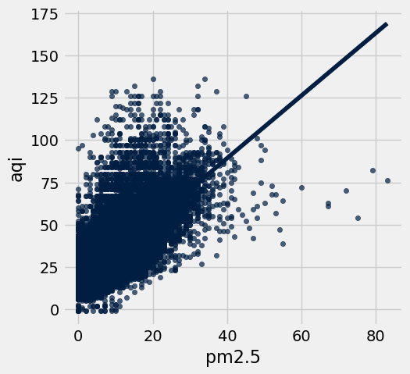
Part 2:
Which pairs of numerical variables did I look at? Pm2.5 and AQI
What was the confidence interval for correlation between these two variables? 95% CI: [0.7469, 0.7528]
What value of x was your input for prediction? x = 50
What was your 99% prediction interval? [107.32, 108.54]
Were there any potential biases or issues you saw in your analysis? Yes some.
Notes:
PM2.5 represents the concentration of tiny particulate matter in the air while AQI is an index that tells us how polluted the air is. I chose these because they’re both numerical and seem directly related, making them a good fit for linear regression. The goal was to see if there’s a clear relationship between the two and use that to make predictions about air quality.
Now to look at the gsimple linear regression graph - This graph shows a positive linear relationship between PM2.5 and AQI meaning that as PM2.5 levels increase AQI also increases. Most of the data points are clustered at lower PM2.5 values but the trend becomes clearer as PM2.5 rises which makes it a good predictor for AQI. However, there are a few outliers at higher PM2.5 levels that might slightly influence the fit of the line.
The residuals graph shows that most residual points are close to zero, which means the model predicts well but there are some slight mispatterns/outliers in the residuals. This shows the relationship isnt linear hinting that there could be other factors or non-linear patterns influencing AQI.
the 95% confidence interval for the correlation between PM2.5 and AQI is: [0.7469, 0.7528] This means that I am 95% confident the true correlation between PM2.5 and AQI falls within this range. Since this interval does not include 0 it indicates a statistically significant positive linear relationship between the two variables.
For the prediction I chose x = 50 (PM2.5 concentration) because it’s near the center of the range making it a reliable input for the model.
My 99% prediction interval was [107.32, 108.54] meaning I’m 99% confident that the predicted AQI for a PM2.5 of 50 falls within that range.
As for biases I noticed that the dataset might not be a simple random sample which could affect the results. If the data was collected under specific conditions or left out certain groups, it might not represent the entire population accurately. Another issue is that I assumed a linear relationship between PM2.5 and AQI which could miss more complex patterns. Also the range of values in the dataset might not cover all possibilities, so predictions might not generalize well to cases outside the data

Slide 4
Part 3:
My features? Included PM2.5, PM10, and SO2
How I will build my classifier.
I will use the k-Nearest Neighbors (k-NN) method for classification.
The dataset will be shuffled and split into 75% training data and 25% testing data.
The classifier will calculate Euclidean distances between the features of the test row and all rows in the training set.
The labels of the nearest k rows (starting with k=3) will be used for majority voting to predict the label.
The accuracy of the classifier will be tested on the test set, and adjustments will be made if necessary.
Notes:
For part 3, my features included PM2.5, PM10, and SO2. These are numerical variables from my dataset that seem relevant to classifying air quality into different groups. They represent different types of pollutants and their combined values should help determine the air quality
Mention issue and couldnt get accuracy
I plan to use the k-Nearest Neighbors algorithm for classification. First I’ll split my dataset into training and test sets by shuffling the data and using 75% for training and 25% for testing. My classifier will calculate the Euclidean distance between the features of a test row and all the rows in the training set. Then it will use the labels of the nearest k rows to predict the label for the test row. I’ll start with k=3 to ensure an odd number of neighbors for easier majority voting and evaluate the classifier's accuracy on the test set.

Slide 5
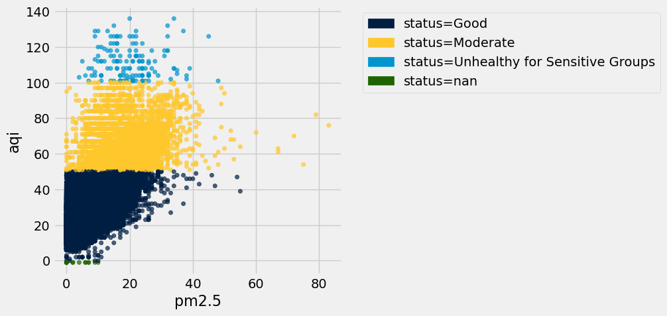
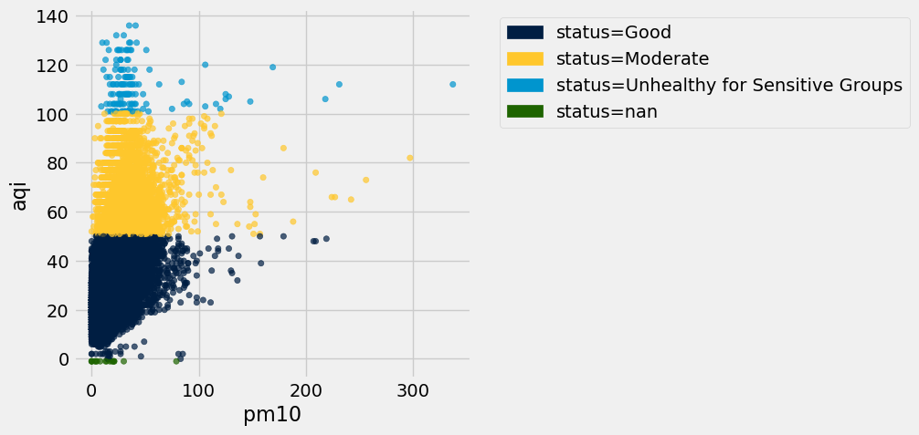
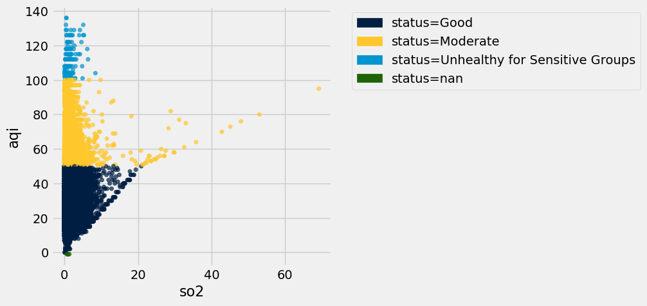
Part 4:
What did I learn?
PM2.5 has a strong linear relationship with AQI, making it a reliable predictor for air quality.
The data may have biases, such as not being a simple random sample, which could affect generalizability.
Big Question my classifier will explore -> Can pollutant levels (PM2.5, PM10, SO2) reliably categorize air quality as good or bad?
This project taught me the importance of splitting data for training and testing and ensuring it is representative.
I gained a deeper understanding of regression, classification, and working with real-world datasets.
Notes:
Scatte plots shown displaying relationships between differny variables. From working with my dataset, I learned a lot about its structure and potential for both prediction and classification. One key takeaway is that there’s a strong linear relationship between PM2.5 and AQI, which makes PM2.5 a reliable predictor for air quality when applying regression techniques. I also observed that certain variables like PM10 and SO2contribute to distinguishing different air quality which will be helpful in building my classifier. However I noticed potential biases such as the possibility of the data not being a simple random sample or excluding certain conditions, which could affect the generalizability of my analysis. This means the data might not represent all possible cases because it wasn’t collected randomly, so the results might not apply to other situations.
While exploring the dataset, I realized how important it is to carefully select features and account for patterns or outliers that could skew predictions or misclassifications. The classifier I aim to build will answer whether specific pollutant levels, like PM2.5, PM10, and SO2, could reliably categorize air quality into either being good or bad. This project showed me how classification algorithms like k-NN rely heavily on well chosen features and accurate training data to make meaningful predictions.
Through this course, I gained a deeper understanding of regression, classification, and how to handle real-world datasets. I now appreciate the importance of splitting data into training and testing sets to evaluate models effectively and the significance of ensuring the data is representative.

